Slide 1
Retro Golf Game Update
Project Overview and Progress Report
Matthew Fish
15/01/24

Slide 2
Project Vision and Background
Retro Golf's vision is to deliver a playable SPA web game that will give off a mini golf experience.
Features of customizable characters and items.
Retro Golf has emerged from a passion for nostalgic games, drawing inspiration from games like raft wars and 8 ball pool.
The aim is to provide players with a nostalgic journey through a classic mini golf web game.

Slide 3
Project Plan and sprints
Sprint | Date | Tasks to take place | Issues that need to be raised | Review of Meeting
1 | 29/11/23 | • Create Game Design Document • Product backlog - Functional requirements need to be defined, Create users' stories • Research any issues that might take place | • Currently no issues | Overall successful. The game idea has now been chosen and the GDD and product backlog will be completed before the next sprint. No issues have risen so far but research will be taken place on issues or concerns that may arise throughout the project, so that they are expected and will be handled easier.
2 | 13/12/23 | • Create the UML diagrams • Develop initial prototype for home page | • Currently no issues | Overall successful. The game design document had now been completed, alongside the product backlog, so now tasks can be planned more effectively meaning deadlines will not be missed. Issues and challenges have been researched and noted down to make sure that they can be tackled easier if they appear. The initial prototype is now the priority to get completed so that an overall idea for the game can be shown.
Plan
Targeted to males aged 18-24
Leaderboard to track score and minutes spent playing
Controls for shot angle and power
Different themes across each level
Customizable Features

Slide 4
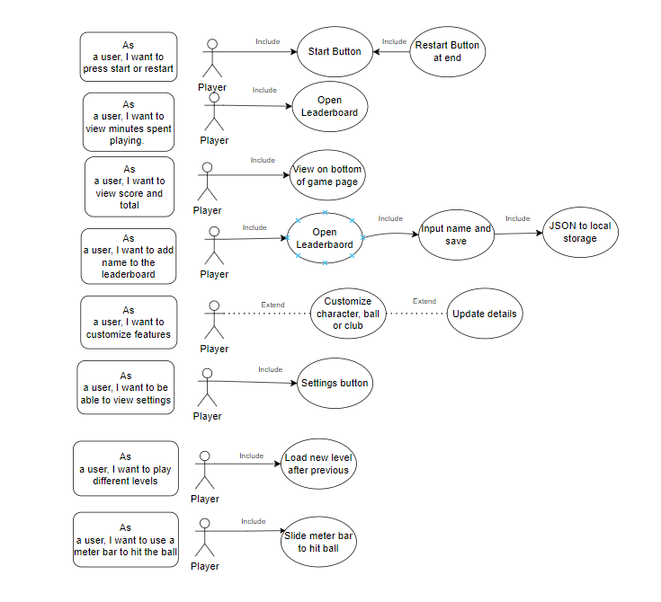
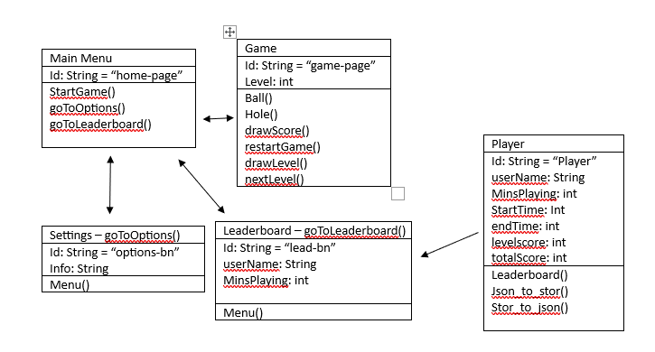
UML models
User Cases
Class Diagrams

Slide 5
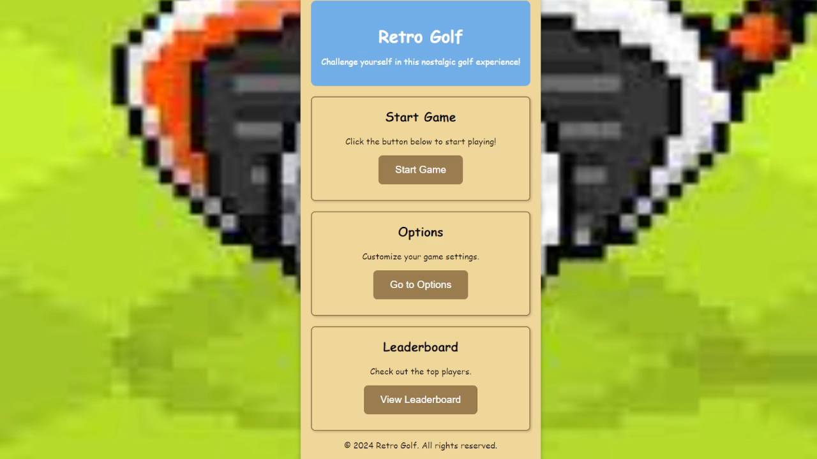
Initial Prototype

Slide 6
Issues and Challenges faced
No issues for the first 2 sprints
Issues that may arise: Creating leaderboard, storing data, creating shot power bar, adding customization.
Issues that have been faced: Game functionality, complete redesign of home page caused a small setback.
Biggest Challenge to face: Completing the game in the time.

